Slide 1
Global Covid -19 Dashboard Analysis
File created on: 5/8/2022 2:47:48 PM

Slide 2
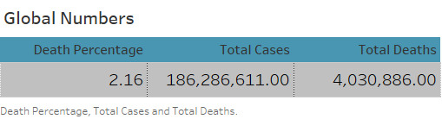

Slide 3
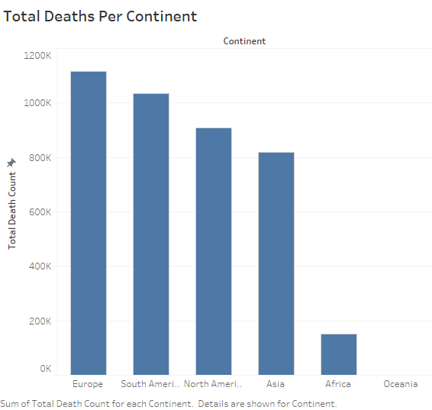

Slide 4
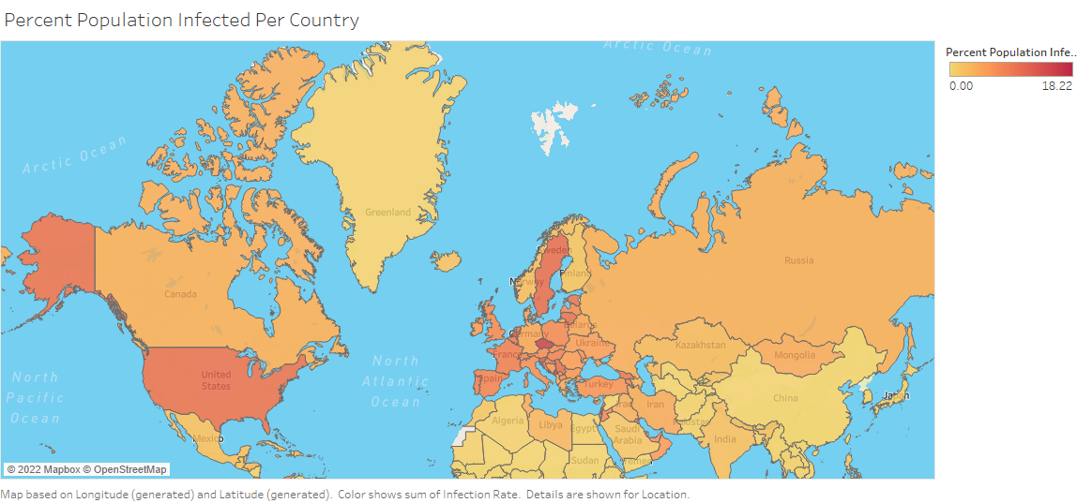

Slide 5
